Slide 1

Project 1
UM BC CLASS
Food Analytics

Slide 2

Food Popularity Data Analytics
Comparison of different general food topics by region
Visualize various data points to give clear insights
Historical information over the last five years and growth among categories

Slide 3
Aims of Project
Many use cases for the data analytics:
Farmers
Restauranteur
Marketing/Advertising
Caterers

Slide 4
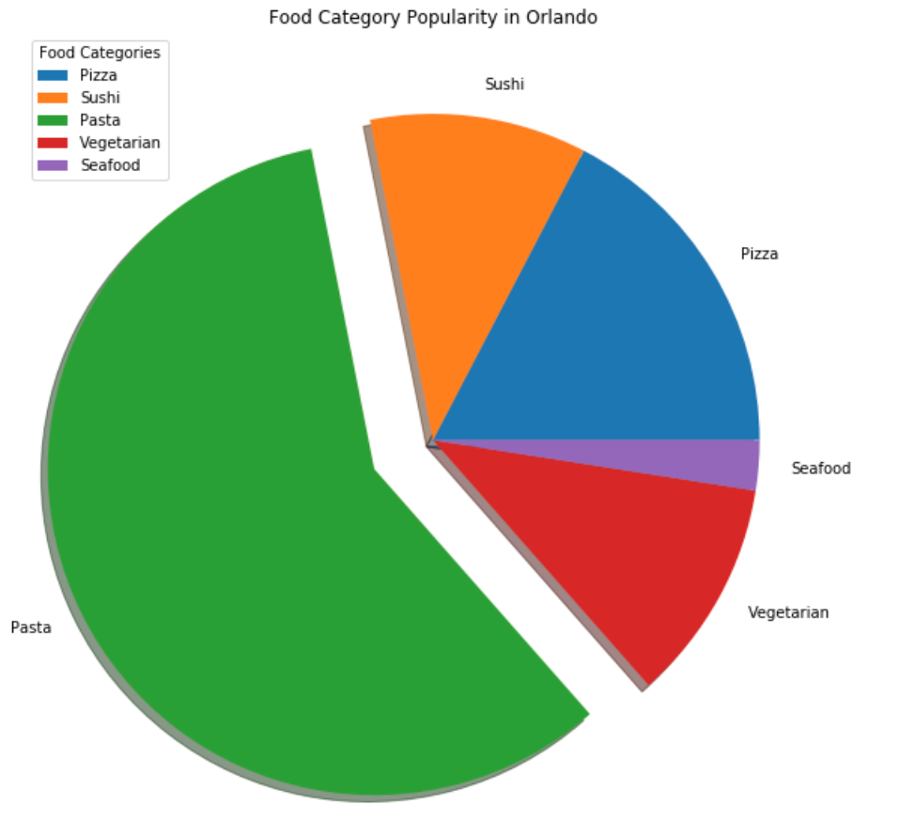
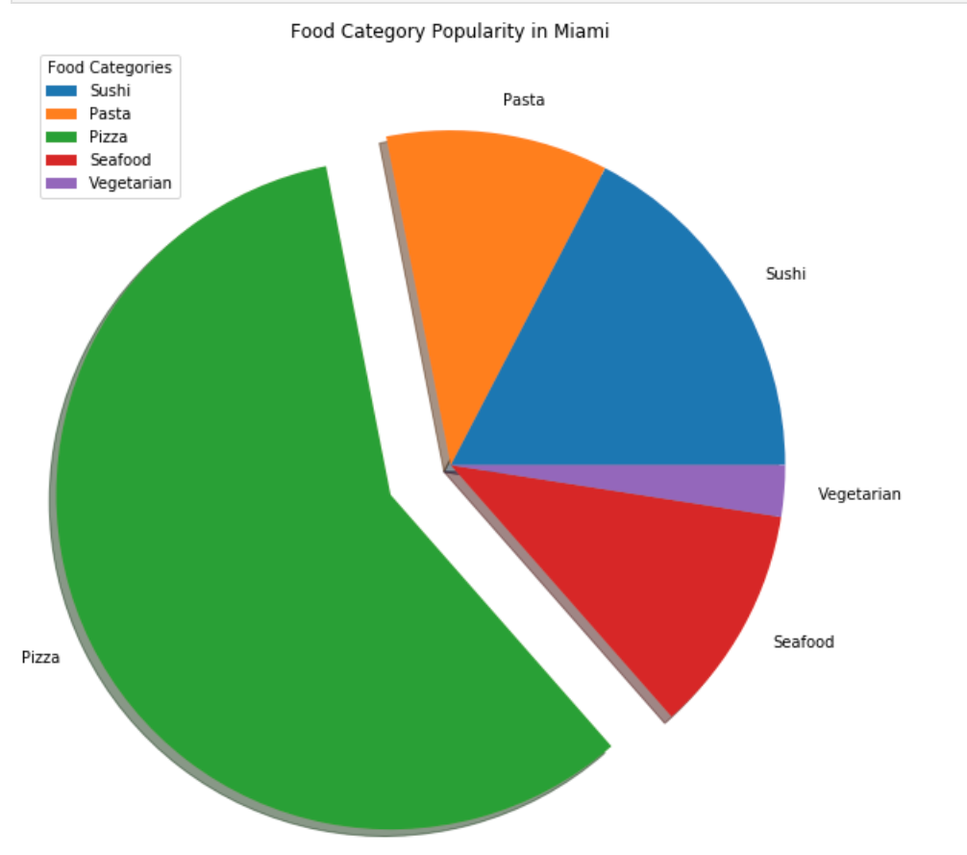
Comparison of Food By Region

Slide 5
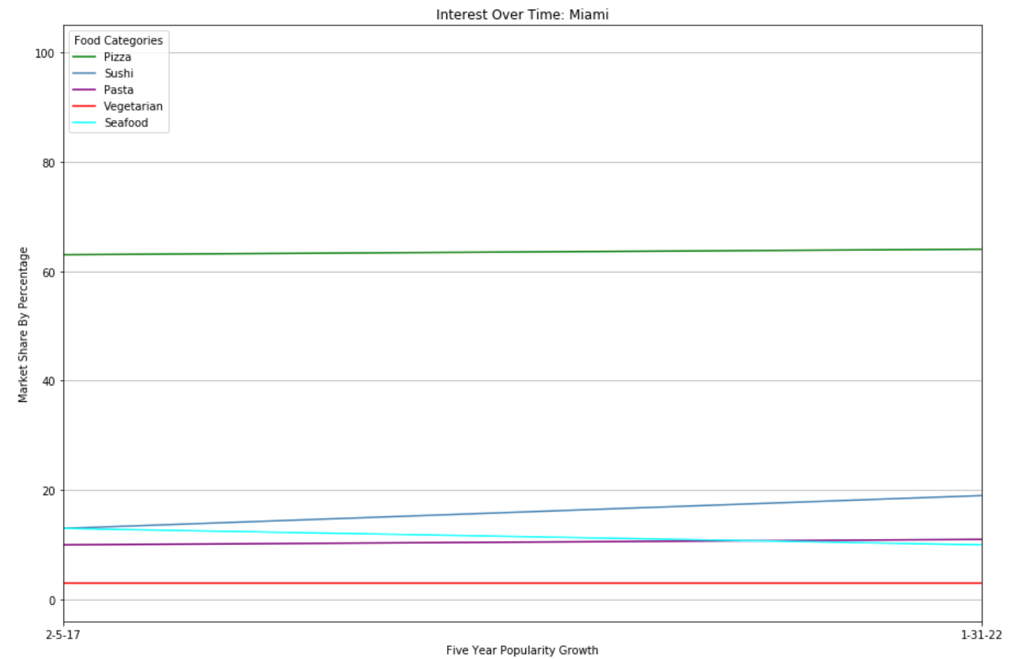
Comparison of Interest Over Time

Slide 6
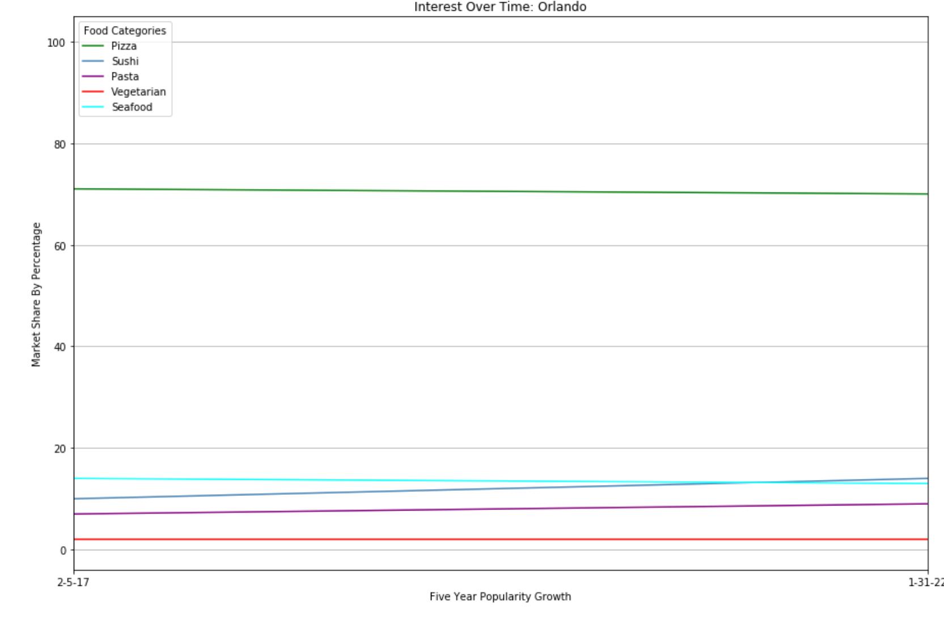
Comparison of Interest Over Time

Slide 7
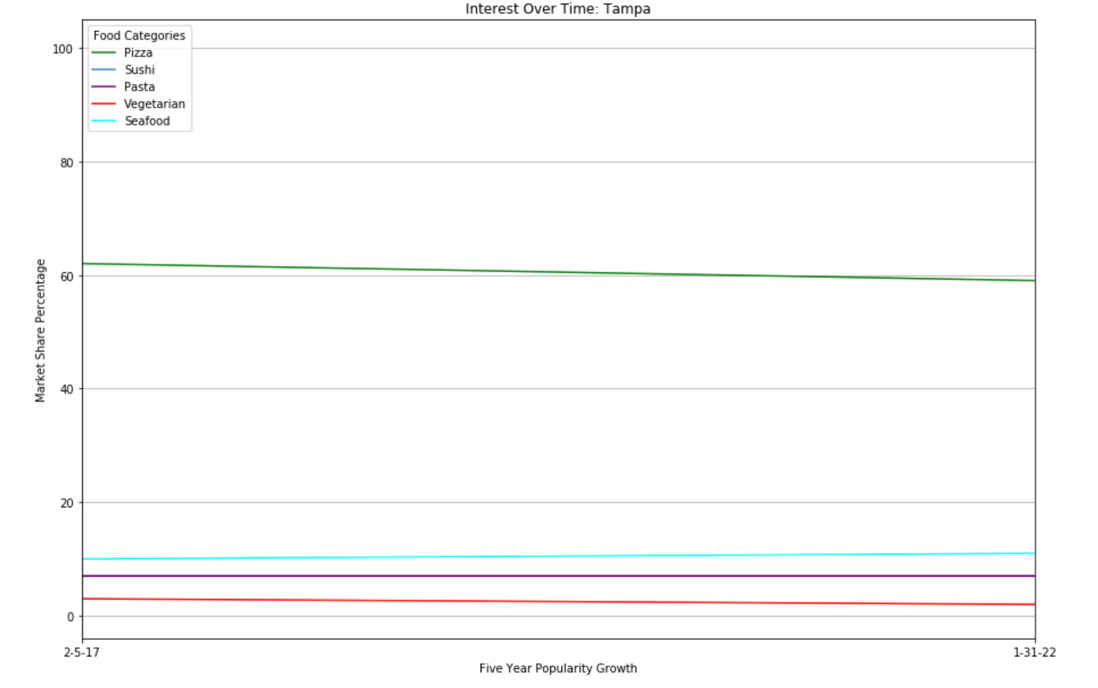
Comparison of Interest Over Time

Slide 8
Insights on Over Time and Comparisons
Pizza in the dominant food category with little to no growth in the last five years in terms of popularity
Tampa serves as an outlier for this as pizza has lost popularity but still is the dominant food category
Sushi experienced the biggest change in growth out of all of the food categories except for in the region of Tampa where the sushi category stayed flat
Vegetarian and Sushi grew parallel with each other being a possible change in younger demographics preferences
Another surprise is that seafood was flat

Slide 9
Dish Comparison

Slide 10
Consumer Habits

Slide 11
Contributors
Eduardo Quin
Anthony Segovia
Clifford Charles

